Slide 1
BAMBOO PROJECT
TEAM MEMBERS-----→
--→Siddhant Pratap Singh(20IT038)
--→Daksh Agarwal(20IT061)
--→Akhil Kumar Singh(20IT049)

Slide 2
INTRODUCTION
Bamboos are a diverse group of evergreen perennial flowering plants in the subfamily Bambusoideae of the grass family Poaceae. The origin of the word "bamboo" is uncertain, but it probably comes from the Dutch or Portuguese language, which originally borrowed it from Malay or Kannada.
In bamboo, as in other grasses, the internodal regions of the stem are usually hollow and the vascular bundles in the cross-section are scattered throughout the stem instead of in a cylindrical arrangement. The dicotyledonous woody xylem is also absent. The absence of secondary growth wood causes the stems of monocots, including the palms and large bamboos, to be columnar rather than tapering.

Slide 3
OBJECTIVE
To promote the use of Bamboo in different fields by making objects which help us in our day to day task. This will somehow reduce the use of nature degrading substances and prevent more natural resources.

Slide 4
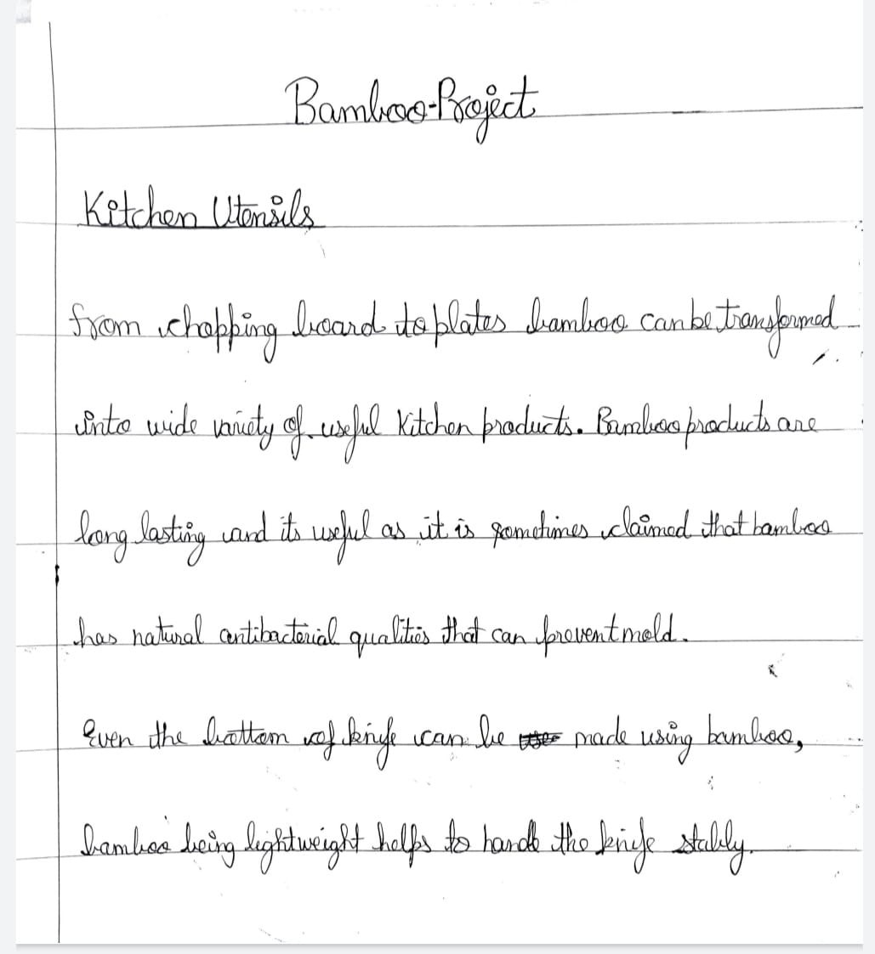

Slide 5
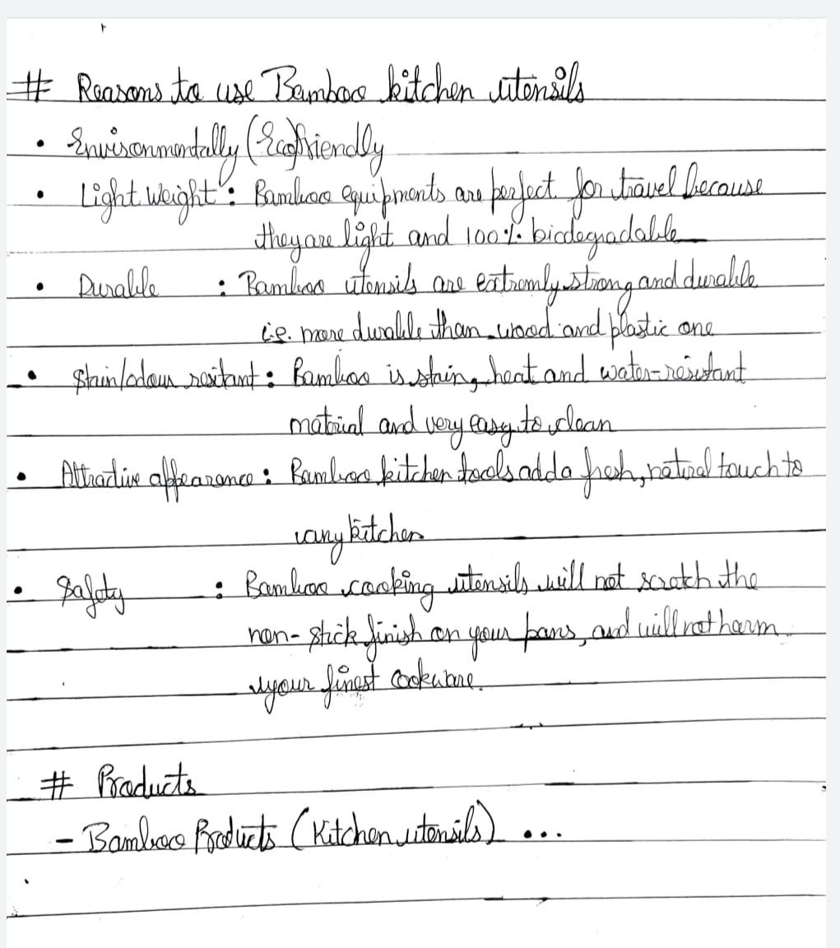
REASONS-→

Slide 6
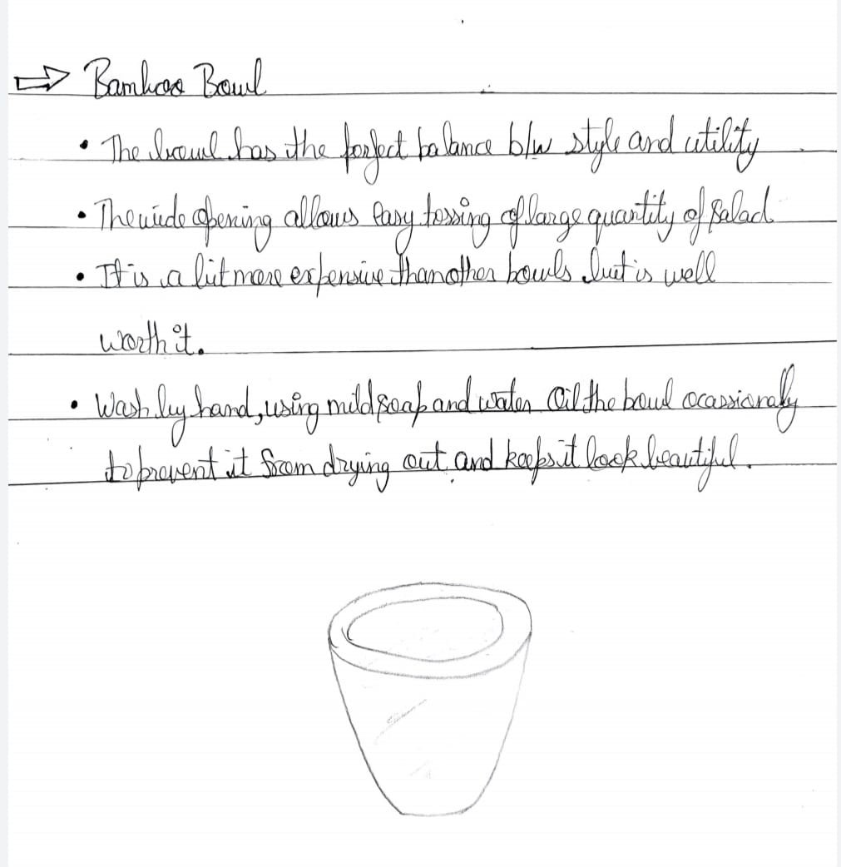
BAMBOO BOWL ---→

Slide 7
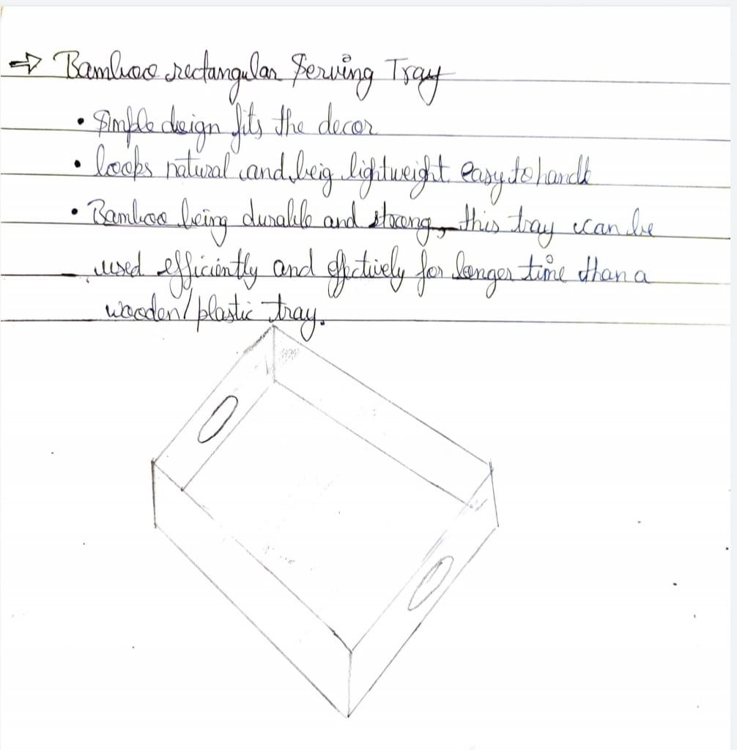
BAMBOO TRAY --→

Slide 8
CONCLUSION
These were the few ways we can create new utensils and increase the use of Bamboo in our day to day life and promote the use of bamboo.

